Slide 1

17. Android – SQL Databases
SQL Databases
Using SQL databases in Android.
Android (as well as iPhone OS) uses an embedded standalone program called sqlite3 which can be used to:
create a database,
define SQL tables,
indices,
queries,
views,
triggers
Insert rows,
delete rows,
change rows,
run queries and
administer a SQLite database file.
1

Slide 2
17. Android – SQL Databases
SQL Databases
Using SQLite
SQLite implements most of the SQL-92 standard for SQL.
It has partial support for triggers and allows most complex queries (exception made for outer joins).
SQLITE does not implement referential integrity constraints through the foreign key constraint model.
SQLite uses a relaxed data typing model.
Instead of assigning a type to an entire column, types are assigned to individual values. This is similar to the Variant type in Visual Basic.
Therefore it is possible to insert a string into numeric column and so on.
Documentation on SQLITE available at http://www.sqlite.org/sqlite.html Good GUI tool for SQLITE available at: http://sqliteadmin.orbmu2k.de/
2

Slide 3
17. Android – SQL Databases
SQL Databases
How to create a SQLite database?
Method 1
public static SQLiteDatabase.openDatabase (
String path, SQLiteDatabase.CursorFactory factory, int flags )
Open the database according to the flags OPEN_READWRITE OPEN_READONLY CREATE_IF_NECESSARY . Sets the locale of the database to the the system's current locale.
Parameters
path to database file to open and/or create
factory an optional factory class that is called to instantiate a cursor when
query is called, or null for default
flags to control database access mode
Returns the newly opened database
Throws SQLiteException if the database cannot be opened
3

Slide 4
17. Android – SQL Databases
SQL Databases
Example 1. Create a SQLite Database
package cis493.sqldatabases;
import android.app.Activity;
import android.database.sqlite.*;
import android.os.Bundle;
import android.widget.Toast;
public class SQLDemo1 extends Activity {
SQLiteDatabase db;
@Override
public void onCreate(Bundle savedInstanceState) {
super.onCreate(savedInstanceState);
setContentView(R.layout.main);
// filePath is a complete destination of the form
// "/data/data/<namespace>/<databaseName>"
// "/sdcard/<databasename>"
// "mnt/sdcard/<databasename>"
try {
db = SQLiteDatabase.openDatabase(
"/data/data/cis493.sqldatabases/myfriendsDB",
null,
SQLiteDatabase.CREATE_IF_NECESSARY);
db.close();
}
catch (SQLiteException e) {
Toast.makeText(this, e.getMessage(), 1).show();
}
}// onCreate
}//class
4

Slide 5
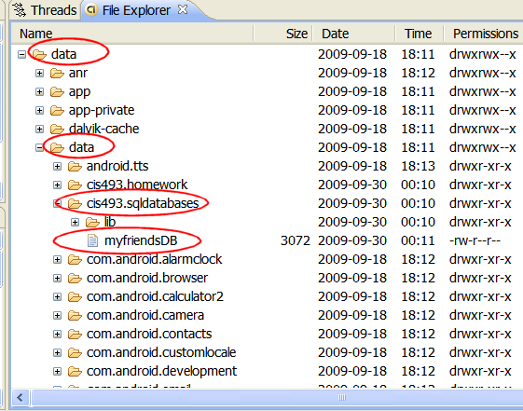
17. Android – SQL Databases
SQL Databases
Example 1. Create a SQLite Database
Android’s System Image
Device’s memory
5

Slide 6
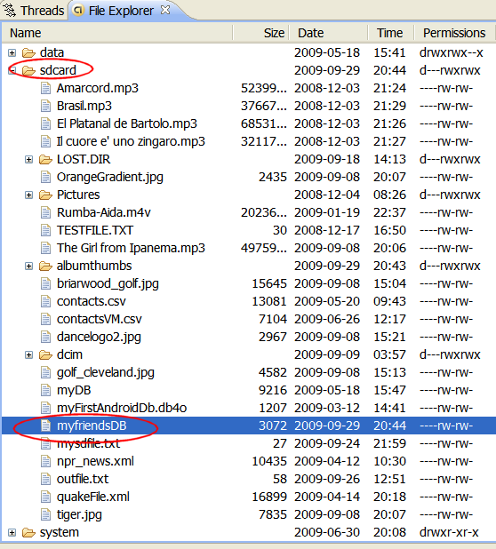
17. Android – SQL Databases
SQL Databases
Example 1. Create a SQLite Database
Creating the database file in the SD card
Using:
db = SQLiteDatabase.openDatabase(
"sdcard/myfriendsDB",
null,
SQLiteDatabase.CREATE_IF_NECESSARY);
6

Slide 7

17. Android – SQL Databases
SQL Databases
Warning
Beware of sharing issues. You cannot access internal databases belonging to other people (instead use Content Providers or external SD resident DBs).
An SD resident database requires the Manifest to include:
<uses-permission android:name="android.permission.WRITE_EXTERNAL_STORAGE" />
NOTE: SQLITE (as well as most DBMSs) is not case sensitive.
7

Slide 8
17. Android – SQL Databases
SQL Databases
Example2 An alternative way of opening/creating a SQLITE database in your local Android’s data space is given below
SQLiteDatabase db = this.openOrCreateDatabase(
"myfriendsDB",
MODE_PRIVATE,
null);
where the assumed prefix for the database stored in the devices RAM is: "/data/data/<CURRENT_namespace>/databases/". For instance if this app is created in a namespace called “cis493.sql1”, the full name of the newly created database will be: “/data/data/cis493.sql1/databases/myfriendsDB”.
This file could later be used by other activities in the app or exported out of the emulator (adb push…) and given to a tool such as SQLITE_ADMINISTRATOR (see notes at the end).
8
8

Slide 9
17. Android – SQL Databases
SQL Databases
Example2 An alternative way of opening/creating a SQLITE database in your local Android’s System Image is given below
SQLiteDatabase db = this.openOrCreateDatabase(
"myfriendsDB2",
MODE_PRIVATE,
null);
Where:
“myFriendsDB2” is the abbreviated file path. The prefix is assigned by Android as: /data/data/<app namespace>/databases/myFriendsDB2.
MODE could be: MODE_PRIVATE, MODE_WORLD_READABLE, and MODE_WORLD_WRITEABLE. Meaningful for apps consisting of multiples activities.
null refers to optional factory class parameter (skip for now)
9

Slide 10
17. Android – SQL Databases
SQL Databases
Example2 An alternative way of opening/creating a SQLITE database in your local Android’s System Image is given below
SQLiteDatabase db = this.openOrCreateDatabase(
"myfriendsDB2",
MODE_PRIVATE,
null);
Where:
“myFriendsDB2” is the abbreviated file path. The prefix is assigned by Android as: /data/data/<app namespace>/databases/myFriendsDB2.
MODE could be: MODE_PRIVATE, MODE_WORLD_READABLE, and MODE_WORLD_WRITEABLE. Meaningful for apps consisting of multiples activities.
null refers to optional factory class parameter (skip for now)
10

Slide 11
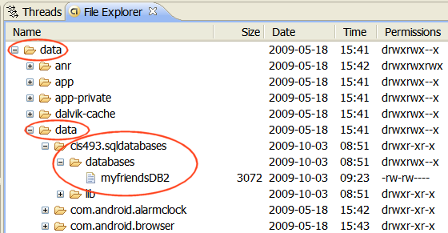
17. Android – SQL Databases
SQL Databases
Example2. Database is saved in the device’s memory
11

Slide 12
17. Android – SQL Databases
SQL Databases
Executing SQL commands on the Database
Once created, the database is ready for normal operations such as:
creating, altering, dropping resources (tables, indices, triggers, views, queries etc.) or administrating database resources (containers, users, …).
Action queries and Retrieval queries represent the most common operations against the database.
A retrieval query is typically a SQL-Select command in which a table holding a number of fields and rows is produced as an answer to a data request.
An action query usually performs maintenance and administrative tasks such as manipulating tables, users, environment, etc.
12

Slide 13
17. Android – SQL Databases
SQL Databases
Transaction Processing Transactions are desirable because they contribute to maintain consistent data and prevent unwanted losses due to abnormal termination of execution.
In general it is convenient to process action queries inside the protective frame of a database transaction in which the policy of “complete success or total failure” is transparently enforced.
This notion is called: atomicity to reflect that all parts of a method are fused in an indivisible-like statement.
13

Slide 14
17. Android – SQL Databases
SQL Databases
Transaction Processing
The typical Android way of running transactions on a SQLiteDatabase is illustrated in the following fragment (Assume db is defined as a SQLiteDatabase)
db.beginTransaction();
try {
//perform your database operations here ...
db.setTransactionSuccessful(); //commit your changes
}
catch (SQLiteException e) {
//report problem
}
finally {
db.endTransaction();
}
The transaction is defined between the methods: beginTransaction and endTransaction. You need to issue the setTransactionSuccessful()call to commit any changes. The absence of it provokes an implicit rollback; consequently the database is reset to the state previous to the beginning of the transaction
14

Slide 15
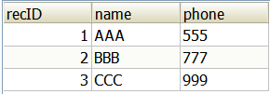
17. Android – SQL Databases
SQL Databases
Creating-Populating a Table SQL Syntax for the creating and populating of a table looks like this:
create table tblAMIGO (
recID integer PRIMARY KEY autoincrement,
name text,
phone text );
insert into tblAMIGO(name, phone) values ('AAA', '555' );
15
15

Slide 16
17. Android – SQL Databases
SQL Databases
Creating-Populating a Table We will use the execSQL(…) method to manipulate SQL action queries. The following example creates a new table called tblAmigo.
The table has three fields: a numeric unique identifier called recID, and two string fields representing our friend’s name and phone. If a table with such a name exists it is first dropped and then created anew. Finally three rows are inserted in the table. Note: for presentation economy we do not show the entire code which should include a transaction frame.
db.execSQL("create table tblAMIGO ("
+ " recID integer PRIMARY KEY autoincrement, "
+ " name text, "
+ " phone text ); " );
db.execSQL( "insert into tblAMIGO(name, phone) values ('AAA', '555' );" );
db.execSQL( "insert into tblAMIGO(name, phone) values ('BBB', '777' );" );
db.execSQL( "insert into tblAMIGO(name, phone) values ('CCC', '999' );" );
16

Slide 17
17. Android – SQL Databases
SQL Databases
Creating-Populating a Table Comments
The field recID is defined as PRIMARY KEY of the table. The “autoincrement” feature guarantees that each new record will be given a unique serial number (0,1,2,…).
The database data types are very simple, for instance we will use:
text, varchar, integer, float, numeric, date, time, timestamp, blob, boolean, and so on.
In general, any well-formed SQL action command (insert, delete, update, create, drop, alter, etc.) could be framed inside an execSQL(…) method.
You should make the call to execSQL inside of a try-catch-finally block. Be aware of potential SQLiteException situations thrown by the method.
17

Slide 18
17. Android – SQL Databases
SQL Databases
Creating-Populating a Table
NOTE:
SQLITE uses an invisible field called ROWID to uniquely identify each row in each table.
Consequently in our example the field: recID and the database ROWID are functionally similar.
18

Slide 19
17. Android – SQL Databases
SQL Databases
Asking SQL Questions
Retrieval queries are SQL-select statements.
Answers produced by retrieval queries are always held in an output table.
In order to process the resulting rows, the user should provide a cursor device. Cursors allow a row-by-row access of the records returned by the retrieval queries.
Android offers two mechanisms for phrasing SQL-select statements:
rawQueries and simple queries. Both return a database cursor.
Raw queries take for input a syntactically correct SQL-select statement. The select query could be as complex as needed and involve any number of tables (remember that outer joins are not supported).
Simple queries are compact parametized select-like statements that operate on a single table (for developers who prefer not to use SQL).
19

Slide 20
17. Android – SQL Databases
SQL Databases
SQL Select Syntax (see http://www.sqlite.org/lang.html )
SQL-select statements are based on the following components
select field₁, field₂, … , field_{n}
from table₁, table₂, … , table_{n}
where ( restriction-join-conditions )
order by field_{n1}, …, field_{nm}
group by field_{m1}, … , field_{mk}
having (group-condition)
The first two lines are mandatory, the rest is optional.
20

Slide 21
17. Android – SQL Databases
SQL Databases
SQL Select Syntax (see http://www.sqlite.org/lang.html )
Examples
select LastName, cellPhone
from ClientTable
where state = ‘Ohio’
order by LastName
select city, count(*) as TotalClients
from ClientTable
group by city
21

Slide 22
17. Android – SQL Databases
SQL Databases
Example1. Using RawQuery (version 1)
Consider the following code fragment
Cursor c1 = db.rawQuery(
"select count(*) as Total from tblAMIGO",
null);
The previous rawQuery contains a select-statement that counts the rows in the table tblAMIGO.
The result of this count is held in a table having only one row and one column. The column is called “Total”.
The cursor c1 will be used to traverse the rows (one!) of the resulting table.
Fetching a row using cursor c1 requires advancing to the next record in the answer set.
Later the (singleton) field total must be bound to a local Java variable.
Soon we will show how to do that.
22

Slide 23
17. Android – SQL Databases
SQL Databases
Example2. Using Parametized RawQuery (version 2)
Using arguments. Assume we want to count how many friends are there whose name is ‘BBB’ and their recID > 1. We could use the following construction
String mySQL = "select count(*) as Total "
+ " from tblAmigo "
+ " where recID > ? "
+ " and name = ? ";
String[] args = {"1", "BBB"};
Cursor c1 = db.rawQuery(mySQL, args);
Parameters
23

Slide 24

17. Android – SQL Databases
SQL Databases
Example2. Using Parametized RawQuery (version 2)
Using arguments.
After the substitutions are made the resulting SQL statement is:
select count(*) as Total
from tblAmigo
where recID > 1
and name = ‘BBB’
NOTE:
Partial matching using expressions such as: name like ‘?%’ are not working now. Wait for an Android fix! (see similar issue: http://code.google.com/p/android/issues/detail?id=2619)
Similarly String.format(…) fails to properly work in cases such as: name like ‘%s%’. note the second % is the SQL wild-character symbol, not an invalid string format!
24

Slide 25
17. Android – SQL Databases
SQL Databases
Example2. Using RawQuery (version 3)
Using arguments. Assume we want to count how many friends are there whose name is ‘BBB’ and their recID > 1. We could concatenate pieces of the string. Special care around (single) quoted strings.
String[] args = {"1", "BBB"};
String mySQL = " select count(*) as Total "
+ " from tblAmigo "
+ " where recID > " + args[0]
+ " and name = '" + args[1] + "'";
Cursor c1 = db.rawQuery(mySQL, null);
25

Slide 26
17. Android – SQL Databases
SQL Databases
Simple Queries Simple queries use a template implicitly representing a condensed version of a typical (non-joining) SQL select statement. No explicit SQL statement is made.
Simple queries can only retrieve data from a single table.
The method’s signature has a fixed sequence of seven arguments representing:
the table name,
the columns to be retrieved,
the search condition (where-clause),
arguments for the where-clause,
the group-by clause,
having-clause, and
the order-by clause.
26

Slide 27
17. Android – SQL Databases
SQL Databases
Simple Queries The signature of the Android’s simple query method is:
query ( String table,
String[] columns,
String selection,
String[] selectionArgs,
String groupBy,
String having,
String orderBy )
27

Slide 28
17. Android – SQL Databases
SQL Databases
Simple Queries. Example 1 Query the EmployeeTable, find the average salary of female employees supervised by 123456789. Report results by Dno. List first the highest average, and so on, do not include depts. having less than two employees.
String[] columns = {"Dno", "Avg(Salary) as AVG"}; String[] conditionArgs = {"F", "123456789"}; Cursor c = db.query ( "EmployeeTable", columns, "sex = ? And superSsn = ? " , conditionArgs, "Dno", "Count(*) > 2", "AVG Desc " ); | ← table name ← columns ← condition ← condition args ← group by ← having ← order by
28

Slide 29
17. Android – SQL Databases
SQL Databases
Simple Queries. Example 2 The following query selects from each row of the tblAMIGO table the columns: recID, name, and phone. RecID must be greather than 2, and names must begin with ‘B’ and have three or more letters.
String [] columns = {"recID", "name", "phone"};
Cursor c1 = db.query (
"tblAMIGO",
columns,
"recID > 2 and length(name) >= 3 and name like 'B%' ",
null, null, null,
"recID" );
int theTotal = c1.getCount();
29

Slide 30
17. Android – SQL Databases
SQL Databases
Simple Queries. Example 2 (cont.)
The String array columns holds the name of fields to be selected.
The retrieval condition is explicitly provided.
Several fields are missing in the call including: selectionArgs, group-by, and having-clause. Instead the null value is used to signal their absence.
The last argument indicates the result should be sorted on “recID” sequence.
String [] columns = {"recID", "name", "phone"};
Cursor c1 = db.query (
"tblAMIGO",
columns,
"recID > 2 and length(name) >= 3 and name like 'B%' ",
null, null, null,
"recID" );
30

Slide 31
17. Android – SQL Databases
SQL Databases
Simple Queries. Example 3 In this example we will construct a more complex SQL select statement.
We are interested in tallying how many groups of friends whose recID > 3 have the same name. In addition, we want to see ‘name’ groups having no more than four people each.
A possible SQL-select statement for this query would be something like:
select name, count(*) as TotalSubGroup
from tblAMIGO
where recID > 3
group by name
having count(*) <= 4;
31

Slide 32
17. Android – SQL Databases
SQL Databases
Simple Queries. Example 3 (cont.) An Android solution for the problem using a simple template query follows.
String [] selectColumns = {"name", "count(*) as TotalSubGroup"};
String whereCondition = "recID > ?";
String [] whereConditionArgs = {"3"};
String groupBy = "name";
String having = "count(*) <= 4";
String orderBy = "name";
Cursor myCur = db.query (
"tblAMIGO",
selectColumns,
whereCondition, whereConditionArgs,
groupBy,
having,
null );
32

Slide 33
17. Android – SQL Databases
SQL Databases
Simple Queries. Example 3 (cont.)
Observations
The selectColumns array indicates two fields name which is already part of the table, and TotalSubGroup which is to be computed as the count(*) of each name sub-group.
The symbol ? in the whereCondition is a place-marker for a substitution. The value “3” taken from the whereConditionArgs is to be injected there.
The groupBy clause uses ‘name’ as a key to create sub-groups of rows with the same name value. The having clause makes sure we only choose subgroups no larger than four people.
33

Slide 34
17. Android – SQL Databases
SQL Databases
Cursors
Android cursors are used to gain (sequential & random) access to tables produced by SQL select statements.
Cursors primarily provide one row-at-the-time operations on a table.
Cursors include several types of operators, among them:
Positional awareness operators (isFirst(), isLast(), isBeforeFirst(), isAfterLast() ),
Record Navigation (moveToFirst(), moveToLast(), moveToNext(), moveToPrevious(), move(n) )
Field extraction (getInt, getString, getFloat, getBlob, getDate, etc.)
Schema inspection (getColumnName, getColumnNames, getColumnIndex, getColumnCount, getCount)
34

Slide 35
17. Android – SQL Databases
SQL Databases
Example 4. Cursors
The following example uses a cursor to handle the individual results of a SQL statement.
The select-command extracts from the tblAMIGO table the values indicated in the columns array, namely: recID, name, and phone.
The getColumnIndex method is called to determine the position of chosen columns in the current row.
The getters: getInt, getString commands are used for field extraction.
The moveToNext command forces the cursor to displace from its before-first position to the first available row.
The loop is executed until the cursor cannot be advanced any further.
35

Slide 36
17. Android – SQL Databases
SQL Databases
Example 4. Cursors
String [] columns ={"recID", "name", "phone"};
Cursor myCur = db.query("tblAMIGO", columns,
null, null, null, null, "recID");
int idCol = myCur.getColumnIndex("recID");
int nameCol = myCur.getColumnIndex("name");
int phoneCol = myCur.getColumnIndex("phone");
while (myCur.moveToNext()) {
columns[0] = Integer.toString((myCur.getInt(idCol)));
columns[1] = myCur.getString(nameCol);
columns[2] = myCur.getString(phoneCol);
txtMsg.append("\n" + columns[0] + " "
+ columns[1] + " "
+ columns[2] );
}
36

Slide 37
17. Android – SQL Databases
SQL Databases
SQL Action Queries
Action queries are the SQL way of performing maintenance operations on tables and database resources (i.e. insert, delete, update, create table, drop, …).
Examples:
insert into tblAmigos values ( ‘Macarena’, ‘555-1234’ );
update tblAmigos set name = ‘Maria Macarena’ where phone = ‘555-1234’;
delete from tblAmigos where phone = ‘555-1234’;
create table Temp ( column1 int, column2 text, column3 date );
drop table Temp;
37
37

Slide 38
17. Android – SQL Databases
SQL Databases
SQL Action Queries
Cursors provide READ_ONLY access to records.
Early versions of the Android SDK included cursor commands to sequentially modify records. Those operators have been deprecated in Release 1.0.
Methods such as cursor.updateInt(...) and cursor.deleteRow(...) are not valid anymore.
Instead use an action SQL command in an execSQL(...) method (explained in the next section).
38
38

Slide 39
17. Android – SQL Databases
SQL Databases
ExecSQL – Action Queries
Perhaps the simplest Android way to phrase a SQL action query is to ‘stitch’ together the pieces of the SQL statement and give it to the execSQL(…) method.
As an example consider the following case
db.execSQL(
"update tblAMIGO set name = (name || 'XXX') where phone >= '001' ");
this statement appends ‘XXX’ to the name of those whose phone number is equal or greater than ‘001’.
Note
The symbol || is the SQL concatenate operator
39

Slide 40
17. Android – SQL Databases
SQL Databases
ExecSQL – Action Queries (cont.) Consider the action query:
db.execSQL(
"update tblAMIGO set name = (name || 'XXX') where phone >= '001' ");
Alternatively, the SQL statement could be ‘pasted’ from pieces as follows:
String theValue = " …"; //some phone value goes here
db.execSQL( "update tblAMIGO set name = (name || 'XXX') " + " where phone >= '" + theValue + "' " );
The same strategy could be applied to other SQL statements such as:
“delete from … where…”, “insert into ….”, etc.
40

Slide 41
17. Android – SQL Databases
SQL Databases
Other Android Solutions for Table Maintenance Although they are not as general as the technique suggested in the previous section, Android provides a number of additional methods to perform insert, delete, update operations.
public long insert(String table,
String nullColumnHack,
ContentValues values )
public int update( String table,
ContentValues values,
String whereClause, String[] whereArgs )
public int delete( String table,
String whereClause, String[] whereArgs)
41

Slide 42
17. Android – SQL Databases
SQL Databases
Database insert Operator
public long insert(String table, String nullColumnHack, ContentValues values)
Convenient method for inserting a row into the database.
Parameters
table the table to insert the row into
nullColumnHack SQL doesn't allow inserting a completely empty row,
so if argument values is empty this column will
explicitly be assigned a NULL value.
values this map (name, value) contains the initial column values for the row. The keys should be the column
names and the values the column values
Returns the row ID of the newly inserted row, or -1 if an error
occurred
42

Slide 43
17. Android – SQL Databases
SQL Databases
Example - Database insert Operator
ContentValues initialValues = new ContentValues();
initialValues.put("name", "ABC");
initialValues.put("phone", "101");
int rowPosition = (int) db.insert("tblAMIGO", null, initialValues);
initialValues.put("name", "DEF");
initialValues.put("phone", "202");
rowPosition = (int) db.insert("tblAMIGO", null, initialValues);
initialValues.clear();
rowPosition = (int) db.insert("tblAMIGO", null, initialValues);
rowPosition = (int) db.insert("tblAMIGO", "name", initialValues);
43

Slide 44
17. Android – SQL Databases
SQL Databases
Example - Database insert Operator - Comments
Lines 1-3 define the set of <key, values> called initialValues to be later inserted in a record of the form <recID, name, phone> . Remember that recID is an autoincremented field. All this work is done to pre-assemble the record < ???, “ABCC”, “101”>. Here ??? will be the recID field to be determined by the database when the record is accepted.
Line 4 requests the set of <key, values> held in initialValues to be added to the table tblAMIGO. If the operation fails the insert method returns -1, otherwise the position of the row identifier is returned.
Lines 5-7 define a new set of values to be used as input to the insert operator. The record <???, “DEF”, “202”> is placed after the row previously inserted in table tblAMIGO.
Line 9 resets the map to empty.
Line 10 attempts the insertion of an empty record. SQL rejects the operation and returns -1
Line 11 is similar to the code in Line 10, however the presence of a nullColumnHack variable (“name” in this case) makes SQL change its behavior; the row is generated with null values everywhere except the key autonumber (recID).
44

Slide 45
17. Android – SQL Databases
SQL Databases
Database update Operator
public int update ( String table,
ContentValues values,
String whereClause, String[] whereArgs )
Convenient method for updating rows in the database.
Parameters
table the table to update in
values a map <name,value> from column names to new column values.
null is a valid value that will be translated to NULL.
whereClause the optional WHERE clause to apply when updating.
Passing null will update all rows.
Returns the number of rows affected
45

Slide 46
17. Android – SQL Databases
SQL Databases
Example - Database update Operator
We want to use the “update” method to express the SQL statement:
Update tblAmigo set name = ‘maria’ where (recID > 2 and recID < 7)
Here are the steps to make the call using Android Update Method
String [] whereArgs = {"2", "7"};
ContentValues updValues = new ContentValues();
updValues.put("name", "Maria");
int recAffected = db.update( "tblAMIGO",
updValues,
"recID > ? and recID < ?",
whereArgs );
46

Slide 47
17. Android – SQL Databases
SQL Databases
Example /Comments - Database update Operator
Line 1 defines the String array holding the (two) arguments used by the whereClause.
Lines 2-3 define and populate a map <key, value> to be used by the update operator. The map expresses the idea “set given column to given value”. In our case the “name” field will acquire the value “maria”.
Line 4 invokes the execution of the update operator. After completion it returns the number of records affected by the update (0 If it fails).
In the example a filter is given to select the rows to be updated. In this case the condition is "recID > ? and recID < ?". The ? symbols represent placeholders for values supplied by the array whereArgs. After the substitutions are made the new filter is: "recID > 2 and recID < 7".
47

Slide 48
17. Android – SQL Databases
SQL Databases
Database delete Operator
public int delete ( String table, String whereClause, String[] whereArgs )
Convenient method for deleting rows in the database.
Parameters
table the table to delete from
whereClause the optional WHERE clause to apply when deleting. Passing
null will delete all rows.
Returns the number of rows affected if a whereClause is passed in,
0 otherwise.
To remove all rows and get a count pass "1" as the whereClause.
48

Slide 49
17. Android – SQL Databases
SQL Databases
Example - Database delete Operator
Consider the following SQL statement:
Delete from tblAmigo wehere recID > 2 and recID < 7
An equivalent version using the delete method follows:
1. String [] whereArgs = {"2", "7"};
2. recAffected = db.delete("tblAMIGO",
"recID > ? and recID < ?",
whereArgs);
Line 2 requests the deleting from the tblAMIGO of those records whose recID is in between the values 2, and 7. The actual values are taken from the whereArgs array shown in Line 1. The method returns the number of rows deleted after executing the command.
49

Slide 50
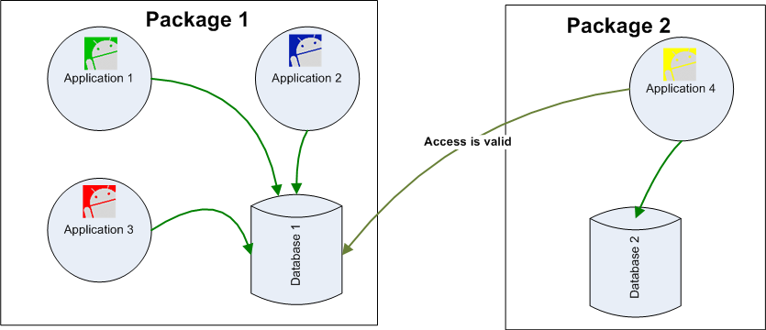
17. Android – SQL Databases
SQL Databases
Database Visibility
Any Application can access an externally SD stored database. All it’s needed is knowledge of the path where the database file is located.
Other ways (ContentProvider) of sharing will be explored later.
50

Slide 51
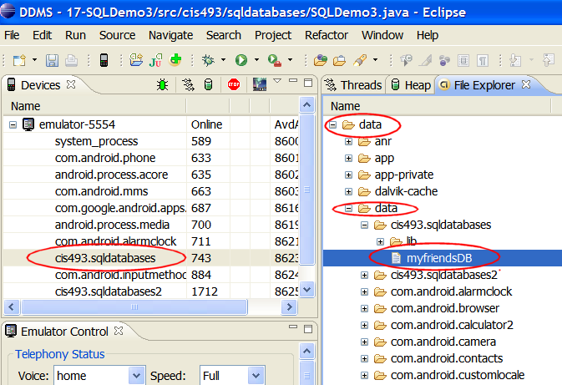
17. Android – SQL Databases
SQL Databases
Database Location
Emulator’s File Explorer showing the placement of the database
51

Slide 52
17. Android – SQL Databases
SQL Databases
Using SQLITE Command Line
The Android SDK contains a command line interface to SQLITE databases.
To open/Create a database use the command
C:> sqlite3 myNewDatabase
You may directly reach the Emulator’s data folder and operate on existing databases.
Assume an emulator is running.
We will use adb shell to tap in the emulator’s internal memory
52

Slide 53
17. Android – SQL Databases
SQL Databases
Using SQLITE Command Line
After opening the DOS command window type the following commands:
Microsoft Windows XP [Version 5.1.2600]
(C) Copyright 1985-2001 Microsoft Corp.
E:\Android> adb shell
# sqlite3 /data/data/matos.sql1/databases/myfriendsDB
sqlite3 /data/data/matos.sql1/databases/myfriendsDB
SQLite version 3.5.9
Enter ".help" for instructions
53

Slide 54
17. Android – SQL Databases
SQL Databases
Using SQLITE Command Line
After opening the DOS command window type the following commands:
sqlite> .tables
.tables
android_metadata tblAMIGO
sqlite> select * from tblAMIGO;
1|AAAXXX|555
2|BBBXXX|777
3|Maria|999
4|Maria|000
5|Maria|001
sqlite> .exit
#
54

Slide 55
17. Android – SQL Databases
SQL Databases
Summary of SQLITE3 commands
sqlite3> .help
.bail ON|OFF Stop after hitting an error. Default OFF .databases List names and files of attached databases .dump ?TABLE? ... Dump the database in an SQL text format .echo ON|OFF Turn command echo on or off .exit Exit this program .explain ON|OFF Turn output mode suitable for EXPLAIN on or off. .header(s) ON|OFF Turn display of headers on or off .help Show this message .import FILE TABLE Import data from FILE into TABLE .indices TABLE Show names of all indices on TABLE .load FILE ?ENTRY? Load an extension library
55
55

Slide 56
17. Android – SQL Databases
SQL Databases
Summary of SQLITE3 commands
.mode MODE ?TABLE? Set output mode where MODE is one of: csv Comma-separated values column Left-aligned columns. (See .width) html HTML <table> code insert SQL insert statements for TABLE line One value per line list Values delimited by .separator string tabs Tab-separated values tcl TCL list elements
.nullvalue STRING Print STRING in place of NULL values .output FILENAME Send output to FILENAME .output stdout Send output to the screen .prompt MAIN CONTINUE Replace the standard prompts
56

Slide 57
17. Android – SQL Databases
SQL Databases
Summary of SQLITE3 commands
.quit Exit this program .read FILENAME Execute SQL in FILENAME .schema ?TABLE? Show the CREATE statements .separator STRING Change separator used by output mode and .import .show Show the current values for various settings .tables ?PATTERN? List names of tables matching a LIKE pattern .timeout MS Try opening locked tables for MS milliseconds .width NUM NUM ... Set column widths for "column" mode
57

Slide 58

17. Android – SQL Databases
SQL Databases
Using GUI Tools for SQLITE
In order to move a copy of the database in and out of the Emulator’s storage space and either receive or send the file into/from the local computer’s file system you may use the commands:
adb pull <full_path_to_database> and
adb push <full_path_to_database>.
You may also use the Eclipse’s DDMS Perspective to
push/pull files in/out the emulator’s file system.
Once the database is in your computer’s disk you may manipulate the database using a ‘user-friendly’ tool such as:
SQLite Manager (Firefox adds-on)
SQLite Administrator (http://sqliteadmin.orbmu2k.de)
58

Slide 59
In this example we use SQLite Administrator.
17. Android – SQL Databases
SQL Databases
Using SQLite Administrator
59

Slide 60
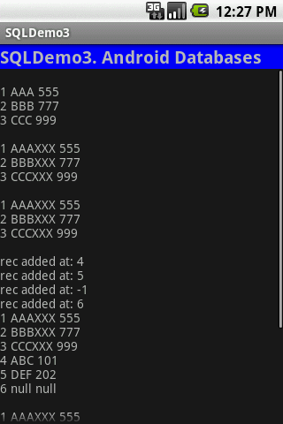
17. Android – SQL Databases
SQL Databases
Example: Complete Listing for Previous Fragments
<?xml version="1.0" encoding="utf-8"?>
<LinearLayout xmlns:android="http://schemas.android.com/apk/res/android"
android:orientation="vertical"
android:layout_width="fill_parent"
android:layout_height="fill_parent"
>
<TextView
android:id="@+id/txtCaption"
android:text="SQLDemo3. Android Databases"
android:layout_width="fill_parent"
android:layout_height="wrap_content"
android:background="#ff0000ff"
android:textSize="20px"
android:textStyle="bold"/>
<ScrollView
android:id="@+id/ScrollView01"
android:layout_width="fill_parent"
android:layout_height="fill_parent">
<TextView
android:id="@+id/txtMsg"
android:text=""
android:layout_width="fill_parent"
android:layout_height="wrap_content" />
</ScrollView>
</LinearLayout>
60

Slide 61
17. Android – SQL Databases
SQL Databases
Example: Complete Listing for Previous Fragments
//USING ANDROID-SQLITE DATABASES
package cis493.sqldatabases;
import android.app.Activity;
import android.content.ContentValues;
import android.database.Cursor;
import android.database.SQLException;
import android.database.sqlite.SQLiteDatabase;
import android.database.sqlite.SQLiteException;
import android.os.Bundle;
import android.widget.TextView;
import android.widget.Toast;
public class SQLDemo3 extends Activity {
SQLiteDatabase db;
TextView txtMsg;
@Override
public void onCreate(Bundle savedInstanceState) {
super.onCreate(savedInstanceState);
setContentView(R.layout.main);
txtMsg = (TextView) findViewById(R.id.txtMsg);
61

Slide 62
17. Android – SQL Databases
SQL Databases
Example: Complete Listing for Previous Fragments
try {
openDatabase(); //open (create if needed) database
dropTable(); //if needed drop table tblAmigos
insertSomeDbData(); //create-populate tblAmigos
useRawQuery1(); //fixed SQL with no arguments
useRawQuery2(); //parameter substitution
useRawQuery3(); //manual string concatenation
useSimpleQuery1(); //simple query
useSimpleQuery2(); //nontrivial 'simple query'
useCursor1(); //retrieve rows from a table
updateDB(); //use execSQL to update
useInsertMethod(); //use insert method
useUpdateMethod(); //use update method
useDeleteMethod(); //use delete method
db.close();//make sure to release the DB
Toast.makeText(this,"All done!",1).show();
} catch (Exception e) {
Toast.makeText(this,e.getMessage(),1).show();
}
}// onCreate
62

Slide 63
17. Android – SQL Databases
SQL Databases
Example: Complete Listing for Previous Fragments [ openDatabase ]
private void openDatabase() {
try {
db = SQLiteDatabase.openDatabase(
"data/data/cis493.sqldatabases/myfriendsDB",
//"sdcard/myfriendsDB",
null,
SQLiteDatabase.CREATE_IF_NECESSARY) ;
Toast.makeText(this, "DB was opened!", 1).show();
}
catch (SQLiteException e) {
Toast.makeText(this, e.getMessage(), 1).show();
}
}//createDatabase
63

Slide 64
17. Android – SQL Databases
SQL Databases
Example: Complete Listing for Previous Fragments [insertSomeDbData]
private void insertSomeDbData() {
//create table: tblAmigo
db.beginTransaction();
try {
db.execSQL("create table tblAMIGO ("
+ " recID integer PRIMARY KEY autoincrement, "
+ " name text, "
+ " phone text ); ");
//commit your changes
db.setTransactionSuccessful();
Toast.makeText(this, "Table was created",1).show();
} catch (SQLException e1) {
Toast.makeText(this, e1.getMessage(),1).show();
}
finally {
//finish transaction processing
db.endTransaction();
}
64

Slide 65
17. Android – SQL Databases
SQL Databases
Example: Complete Listing for Previous Fragments [insertSomeDbData]
// populate table: tblAmigo
db.beginTransaction();
try {
//insert rows
db.execSQL( "insert into tblAMIGO(name, phone) "
+ " values ('AAA', '555' );" );
db.execSQL("insert into tblAMIGO(name, phone) "
+ " values ('BBB', '777' );" );
db.execSQL("insert into tblAMIGO(name, phone) "
+ " values ('CCC', '999' );" );
//commit your changes
db.setTransactionSuccessful();
Toast.makeText(this, " 3 records were inserted",1).show();
}
catch (SQLiteException e2) {
//report problem
Toast.makeText(this, e2.getMessage(),1).show();
}
finally {
db.endTransaction();
}
}//insertSomeData
65

Slide 66
17. Android – SQL Databases
SQL Databases
Example: Complete Listing for Previous Fragments [useRawQuery1]
private void useRawQuery1() {
try {
//hard-coded SQL-select command with no arguments
String mySQL ="select count(*) as Total from tblAMIGO";
Cursor c1 = db.rawQuery(mySQL, null);
int index = c1.getColumnIndex("Total");
//advance to the next record (first rec. if necessary)
c1.moveToNext();
int theTotal = c1.getInt(index);
Toast.makeText(this, "Total1: " + theTotal, 1).show();
} catch (Exception e) {
Toast.makeText(this, e.getMessage(), 1).show();
}
}//useRawQuery1
66

Slide 67
17. Android – SQL Databases
SQL Databases
Example: Complete Listing for Previous Fragments [useRawQuery2]
private void useRawQuery2() {
try {
// ? arguments provided for automatic replacement
String mySQL = " select count(*) as Total "
+ " from tblAmigo "
+ " where recID > ? "
+ " and name = ? ";
String[] args = {"1", "BBB"};
Cursor c1 = db.rawQuery(mySQL, args);
int index = c1.getColumnIndex("Total");
//advance to the next record (first rec. if necessary)
c1.moveToNext();
int theTotal = c1.getInt(index);
Toast.makeText(this, "Total2: " + theTotal, 1).show();
} catch (Exception e) {
Toast.makeText(this, e.getMessage(), 1).show();
}
}//useRawQuery2
67

Slide 68
17. Android – SQL Databases
SQL Databases
Example: Complete Listing for Previous Fragments [useRawQuery3]
private void useRawQuery3() {
try {
//arguments injected by manual string concatenation
String[] args = {"1", "BBB"};
String mySQL = " select count(*) as Total "
+ " from tblAmigo "
+ " where recID > " + args[0]
+ " and name = '" + args[1] + "'";
Cursor c1 = db.rawQuery(mySQL, null);
int index = c1.getColumnIndex("Total");
//advance to the next record (first rec. if necessary)
c1.moveToNext();
int theTotal = c1.getInt(index);
Toast.makeText(this, "Total3: " + theTotal, 1).show();
} catch (Exception e) {
Toast.makeText(this, e.getMessage(), 1).show();
}
}//useRawQuery3
68

Slide 69
17. Android – SQL Databases
SQL Databases
Example: Complete Listing for Previous Fragments [simpleQuery1]
private void useSimpleQuery1() {
try {
//simple (implicit) query on one table
String [] columns = {"recID", "name", "phone"};
Cursor c1 = db.query (
"tblAMIGO",
columns,
"recID > 2 and length(name) >= 3 and name like 'B%' ",
null, null, null,
"recID" );
int theTotal = c1.getCount();
Toast.makeText(this, "Total4: " + theTotal, 1).show();
} catch (Exception e) {
Toast.makeText(this, e.getMessage(), 1).show();
}
}//useSimpleQuery1
69

Slide 70
17. Android – SQL Databases
SQL Databases
Example: Complete Listing for Previous Fragments [simpleQuery2]
private void useSimpleQuery2() {
try {
//nontrivial 'simple query' on one table
String [] selectColumns = {"name", "count(*) as TotalSubGroup"};
String whereCondition = "recID >= ?";
String [] whereConditionArgs = {"1"};
String groupBy = "name";
String having = "count(*) <= 4";
String orderBy = "name";
Cursor c = db.query ( "tblAMIGO",
selectColumns,
whereCondition, whereConditionArgs,
groupBy,
having,
orderBy );
int theTotal = c.getCount();
Toast.makeText(this, "Total5: " + theTotal, 1).show();
} catch (Exception e) {
Toast.makeText(this, e.getMessage(), 1).show();
}
}//useSimpleQuery2
70

Slide 71
17. Android – SQL Databases
SQL Databases
Example: Complete Listing for Previous Fragments [ useCursor1 ]
private void useCursor1() {
try {
txtMsg.append("\n");
// obtain a list of <recId, name, phone> from DB
String[] columns = { "recID", "name", "phone" };
Cursor c = db.query("tblAMIGO", columns,
null, null, null, null, "recID");
int theTotal = c.getCount();
Toast.makeText(this, "Total6: " + theTotal, 1).show();
int idCol = c.getColumnIndex("recID");
int nameCol = c.getColumnIndex("name");
int phoneCol = c.getColumnIndex("phone");
while (c.moveToNext()) {
columns[0] = Integer.toString((c.getInt(idCol)));
columns[1] = c.getString(nameCol);
columns[2] = c.getString(phoneCol);
txtMsg.append( columns[0] + " " + columns[1] + " "
+ columns[2] + "\n" );
}
} catch (Exception e) {
Toast.makeText(this, e.getMessage(), 1).show();
}
}//useCursor1
71

Slide 72
17. Android – SQL Databases
SQL Databases
Example: Complete Listing for Previous Fragments [ updateDB]
private void updateDB(){
//action query using execSQL
String theValue;
try {
theValue = "222";
db.execSQL( " update tblAMIGO "
+ " set name = (name || 'XXX') "
+ " where phone >= '" + theValue + "' " );
useCursor1();
} catch (Exception e) {
Toast.makeText(this,"updateDB " + e.getMessage(), 1).show();
}
useCursor1();
}
72

Slide 73
17. Android – SQL Databases
SQL Databases
Example: Complete Listing for Previous Fragments [ dropTable]
private void dropTable(){
//(clean start) action query to drop table
try {
db.execSQL( " drop table tblAmigo; ");
Toast.makeText(this, "Table dropped", 1).show();
} catch (Exception e) {
Toast.makeText(this,
"dropTable()\n" + e.getMessage(), 1).show();
}
}// dropTable
73

Slide 74
17. Android – SQL Databases
SQL Databases
Example: Complete Listing for Previous Fragments [ useInsertMethod]
public void useInsertMethod() {
ContentValues initialValues = new ContentValues();
initialValues.put("name", "ABC");
initialValues.put("phone", "101");
int rowPosition = (int) db.insert("tblAMIGO", null, initialValues);
txtMsg.append("\nrec added at: " + rowPosition);
initialValues.put("name", "DEF");
initialValues.put("phone", "202");
rowPosition = (int) db.insert("tblAMIGO", null, initialValues);
txtMsg.append("\nrec added at: " + rowPosition);
initialValues.clear();
rowPosition = (int) db.insert("tblAMIGO", null, initialValues);
txtMsg.append("\nrec added at: " + rowPosition);
rowPosition = (int) db.insert("tblAMIGO", "name", initialValues);
txtMsg.append("\nrec added at: " + rowPosition);
useCursor1();
}// useInsertMethod
74

Slide 75
17. Android – SQL Databases
SQL Databases
Example: Complete Listing for Previous Fragments [ useUpdateMethod]
private void useUpdateMethod() {
//using the update method to change name of selected friend
String [] whereArgs = {"2", "7"};
ContentValues updValues = new ContentValues();
updValues.put("name", "Maria");
int recAffected =db.update( "tblAMIGO",
updValues,
"recID > ? and recID < ?",
whereArgs );
Toast.makeText(this, "Total7: " + recAffected, 1).show();
useCursor1();
}
75

Slide 76
17. Android – SQL Databases
SQL Databases
Example: Complete Listing for Previous Fragments [ useDeleteMethod]
private void useDeleteMethod() {
//using the delete method to remove a group of friends
//whose id# is between 2 and 7
String [] whereArgs = {"2", "7"};
int recAffected = db.delete( "tblAMIGO",
"recID > ? and recID < ?",
whereArgs);
Toast.makeText(this, "Total8: " + recAffected, 1).show();
useCursor1();
}// useDeleteMethod
}//class
76

Slide 77
17. Android – SQL Databases
SQL Databases
Questions
77
77

Slide 78
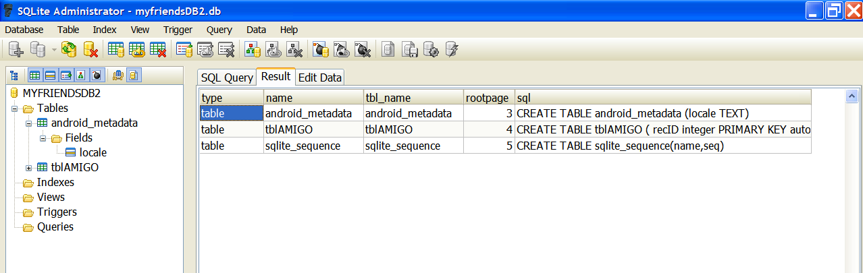
17. Android – SQL Databases
SQL Databases
Appendix 1: Database Dictionary - SQLITE Master Table
You may query the SQLITE master table (named: sqlite_master) looking for a table, index, or other database object.
Example
select * from sqlite_master;
Examination of this field provides the table schema
78
78

Slide 79
17. Android – SQL Databases
SQL Databases
Appendix 1: Database Dictionary - SQLITE Master Table
In Java code you may phrase the test for existence of a database object using something similar to the following fragment
public boolean tableExists(SQLiteDatabase db, String tableName)
{
//true if table exists, false otherwise
String mySql = " SELECT name FROM sqlite_master "
+ " WHERE type='table' "
+ " AND name='" + tableName + "'";
int resultSize = db.rawQuery(mySql, null).getCount();
if (resultSize ==0) {
return true;
} else
return false;
}
79
79

Slide 80
17. Android – SQL Databases
SQL Databases
Appendix 2: Convenient Database Command
In Java code you may phrase the request for “CREATE or REPLACE” a table using the following safe construct:
db.execSQL("DROP TABLE IF EXISTS tableXYZ");
80
80

